Slide 1
Magnifying the Positive Effect of Advertising Spending in Franchising: The Moderating Roles of Franchising Proportion and Franchisee Dispersion
Presented by HAIBO PAN Feb-28-2021

Slide 2
01 Introduction

Slide 3










01 Introduction
Top 10 of 2018 Franchise 500 Ranking

Slide 4
01 Introduction
Business format franchising is a method of business expansion characterized by a trademark license, payment of fees, and significant assistance and / or control (IFA, 2018)
In franchising, one firm (the franchisor) sells the right to market goods or services under its brand name and using its business practices to a second firm ( the franchisee) (Combs, Michael, and Castrogivanni, 2004).
In exchange, franchisees have to pay franchisors up-front fee (is known as franchise fee) and ongoing fees ( is known as royalty fee) for the right. (Combs, Kthchen, Shook, and Short, 2011).
In U.S., it provided nearly 9.0 million jobs and contributed $541.1 billion to GDP in 2016

Slide 5
01 Introduction
Franchising has captured the attentions from different fields:
Entrepreneurship: franchising is a vehicle for entering business ownership ( Shane & Hoy, 1996)
Economics: franchising is a leading venue for understanding the structure of contracts ( Lafontaine, 1992)
Strategic Management: franchising is an important organizational form ( Sorenson ad Sorensen, 2001)
Marketing: franchising is an important distribution channel (Srinivasan, 2006)

Slide 6
02 Idea Generation

Slide 7
02 Idea Generation
Advertising is an essential strategy in franchising.
“franchising” is about “brand”. (IFA, 2020）
brand is tightly bound to advertising. (**)
Advertising spending is viewed as investment in marketing but is cost in financial statements.
Advertising spending is a tradeoff between ”benefits” and “costs”.
How to optimize the advertising spending to achieve maximum value in different situations?
Specifically, when is it an effective strategy to enhance advertising spending? And when is not it an effective strategy?

Slide 8
02 Idea Generation
Empirical studies have shown evidence that advertising spending can influence sales performance.
Goeree, 2008; Gurun et al., 2016; Lodish et al., 1995; Van Heerde et al., 2013.
Few studies in franchising examined the effect of advertising spending empirically.
Few studies in franchising explored the boundary of advertising spending theoretically.

Slide 9
03 Research Questions

Slide 10
02 Research Questions
1. Is there any unique path in franchising though which advertising spending can boost sales?
2. Under which conditions, can the positive effect of advertising spending be magnified in franchising ?

Slide 11
04 Hypotheses Development

Slide 12
04 Theoretical Framework
Previous have identified reveals how advertising works:
Advertising content:
-- informative effect : reduce search costs;
(Ackerberg, 2001; Grossman & Shapiro,1984; Milgrom & Roberts, 1986; Nelson, 1974 )
-- persuasive effect: psychological cues；
brand preference (Ayanwale, Alimi, and Ayanbimipe (2005) ;
brand loyalty: Ha et al (2011)
Advertising frequency:
Brand awareness (Clark et al., 2009; McAlister et al., 2016 )

Slide 13
04 Theoretical Framework
Pros and Cons of Employing franchised Outlets
Pros: flexible adaptation to cater for local demands
(e.g., opening hours, products, prices, etc.)
Cons: free ridings
reducing the quality of products; avoid local advertising responsibilities

Slide 14
04 Theoretical Framework
Franchisee Proportion
Franchisee proportion refers to the proportion of franchised outlets in a franchising system, which can reflect the extent to which franchising systems depend on franchisees.
Franchisee Dispersion
franchisee dispersion refers to the geographic dispersion of franchised outlets in a franchising system, which can reflect the extent to which franchising systems face heterogenous markets.

Slide 15

04 Theoretical Model

Slide 16
04 Hypotheses Development
H1: Advertising spending can boost sales performance.
-- by making the high quality of advertising content
-- by increasing the frequency of advertising
H2: Advertising spending can reduce franchisees’ free ridings.
-- advertising can enhance the monitoring intensity (both informative and frequency)
-- advertising spending is a signal of franchisors’ low tolerance on free ridings; ( increase the cost of free riding)
--- advertising spending is a vehicle to enhance franchisees’ identification to the brand.

Slide 17
H3(a): The relationship between advertising spending and financial performance in franchising system can be strengthened by the proportion of franchisees. Specifically, the positive effect of advertising spending is stronger in franchising systems with a higher proportion of franchisees.
Franchisee proportion can magnify the monitoring effect of advertising;
Franchisee proportion can magnify the effect of advertising on franchisees’ identification.

Slide 18
H3 (b):The relationship between advertising spending and financial performance is weaken can be weakened by franchisee dispersion. Specifically, the positive effect of advertising is weaker in franchising systems with wider franchisee dispersion.
Adaptation increases the variety of operating (e.g., product line; operating hours; etc.)
Franchisee dispersion can weaken the informative effect of advertising contents;
Franchisee dispersion can weaken the persuasive effect of advertising contents;

Slide 19
05 Research Methods

Slide 20
Study 1
Scenario-based experiment
Research Pro + MTurk
50 samples in each unit.
2*2*2 experiment

Slide 21
Study 2
Research Context: U.S.-based business format franchise system
Data Sources: FDD, U.S. Department of Commerce, Entrepreneur
Sample Size: 610 observations from 61 franchisors over 10 years cover 7 industries

Slide 22
Study 2
Endogeneity Issues:
Franchisors’ governance mechanism is deemed as strategic choices rather than random assignments (Antia et al., 2017)
Hausman-Taylor Instrument Variable Methods
Sample Selection Bias Issues:
Some companies does not report advertising costs;
Heckman Selection Model to correct the bias.

Slide 23
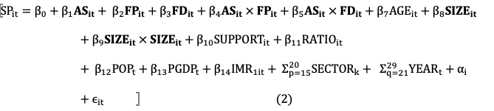
Study 2
$${INCLUDE}_{it}=γ_{0}+γ_{1}{FSIZE}_{it}+γ_{2}{EXP}_{it}+γ_{3}{IFF}_{it}+Σ_{p=4}^{9}γ_{p}{SECTOR}_{k}+u_{it} (1)$$

Slide 24
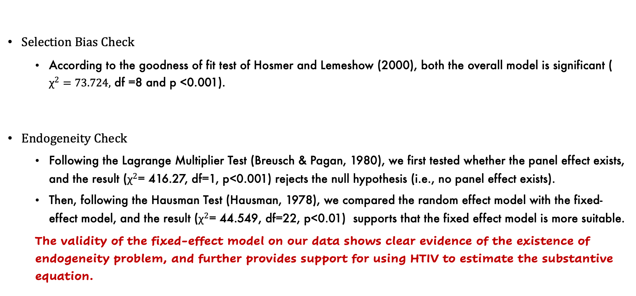
Study 2
Selection Bias Check
According to the goodness of fit test of Hosmer and Lemeshow (2000), both the overall model is significant ( $χ^{2}=73.724,$ df =8 and p <0.001).
Endogeneity Check
Following the Lagrange Multiplier Test (Breusch & Pagan, 1980), we first tested whether the panel effect exists, and the result ($χ^{2}$= 416.27, df=1, p<0.001) rejects the null hypothesis (i.e., no panel effect exists).
Then, following the Hausman Test (Hausman, 1978), we compared the random effect model with the fixed-effect model, and the result ($χ^{2}$= 44.549, df=22, p<0.01) supports that the fixed effect model is more suitable.
The validity of the fixed-effect model on our data shows clear evidence of the existence of endogeneity problem, and further provides support for using HTIV to estimate the substantive equation.

Slide 25
06 Contributions

Slide 26
06 Contributions
Theoretical Contribution:
This paper identified a new path through which advertising spending influence sales performance.
This paper identified two boundaries of the positive effect of advertising spending.

Slide 27

Q&A
Contact Me: haibopan@outlook.com

Slide 28
Which title do you prefer?
When does advertising spending work more effectively in franchising?
Making advertising spending more effective in franchising: The roles of franchisee proportion and franchisee dispersion
Be cautious on advertising spending in franchising! The roles of franchisee proportion and franchisee dispersion
D. Advertising spending in franchising: A franchisee side perspective and boundaries.

Slide 29
Thank You for your time!

